Slide 1







IBM Data Science Capstone Project
Christopher Atkinson
06/02/2023

Slide 2



OUTLINE
Executive Summary
Introduction
Methodology
Results
Visualization – Charts
Dashboard
Discussion
Findings & Implications
Conclusion
Appendix

Slide 3

EXECUTIVE SUMMARY
Summary of methodologies
Data collection
Data wrangling
EDA with data visualization
EDA with SQL
Interactive mapping with folium
Creating dashboards with Plotly Dash
Predictive analysis with machine learning
Summary of results
EDA results
Interactive maps and Dashboard
Machine learning results

Slide 4

INTRODUCTION
Project background and context
SpaceX is one of the most successful space exploration companies in the world, one of the reasons for that is that they advertise Falcon 9 rocket launches on their website with a cost of 62 million dollars; other providers cost upwards of 165 million dollars each, much of the savings is because SpaceX can reuse the first stage. Therefore, if we can determine if the first stage will land, we can determine the cost of a launch. Spaces X’s Falcon 9 launch like regular rockets.
Problems to be answered
How do things like payload mass, launch site, and orbits affect the success of a first stage landing?
Does the success rate change from year to year?
What is the best algorithm to be used for binary classification in our case?

Slide 5

METHODOLOGY
Data collection methodology
The SpaceX rest API
Web scraping Wikipedia
Data Wrangling methodology
Filtering data
Dropping or modifying missing values
Using one hot encoding for classification
Perform EDA using visualization and SQL
Perform interactive visual analytics using classification models

Slide 6
Data Collection
Data was collected from the SpaceX rest API and from Wikipedia using data scraping
The columns from the Wikipedia web scraping are as follows:
Flight No., Launch Site, Payload, PayloadMass, Orbit, Customer, Launch, Outcome, Version Booster, Booster Landing, Date, Time.
The columns for the rest API are as follows:
FlightNumber, Date, BoosterVersion, PayloadMass, Orbit, LaunchSite, Outcome, Flights, GridFins, Reused, Legs, LandingPad, Block, ReusedCount, Serial, Longitude, Latitude.

Slide 7
Data Collection – SpaceX rest API
The steps to collect data from SpaceX’s free rest API are:
Request API and parse for launch data
Filter data down to just the falcon 9 launches
Replace missing values to fill out the dataset
Url for more detail on the data collection process https://github.com/chrisatkinson16/IBM-Applied-Data-Science-Capstone/blob/main/jupyter-labs-spacex-data-collection-api-final.ipynb

Slide 8
Data Collection – Wikipedia
Wikipedia also has some data on SpaceX launches that might be useful so to get that data in a format we need, we use web scraping
Request data from Wikipedia
Create a beautiful soup object out of the HTML response
Extract column names and parse the table to collect the data
Build a dictionary using the collected data and then creating a data frame from that
Export it to a .csv file
https://github.com/chrisatkinson16/IBM-Applied-Data-Science-Capstone/blob/main/jupyter-labs-webscraping-final.ipynb

Slide 9
Data Wrangling
In the dataset several of the cases where the booster did not land successfully, this is where EDA comes in and we analyse the dataset to convert failures and successes into training labels 1 for success and 0 for failure
https://github.com/chrisatkinson16/IBM-Applied-Data-Science-Capstone/blob/main/labs-jupyter-spacex-Data%20wrangling-final.ipynb

Slide 10
EDA with data visualization
Plotting charts for:
Flight number vs payload mass, flight number vs launch site, payload mass vs launch site, orbit vs success rate, flight number vs orbit, payload vs orbit, and the success rate yearly trend
we get a picture of how these variables come into play and have an affect on the success or failure of a launch
https://github.com/chrisatkinson16/IBM-Applied-Data-Science-Capstone/blob/main/jupyter-labs-eda-dataviz-final.ipynb

Slide 11
EDA with SQL
Using SQL we can look at certain subsets of the data to see if we can spot any patterns in the data that might lead to success or failure. Queries such as:
Displaying the names of unique launch sites
Displaying the total payload mass carried by NASA (CRS) boosters
Listing the total number of successful and failed missions
Etc.
the full list of commands used and their outputs can be seen here https://github.com/chrisatkinson16/IBM-Applied-Data-Science-Capstone/blob/main/jupyter-labs-eda-sql-coursera-final.ipynb

Slide 12
Interactive maps with folium
Using folium it is possible to create interactive maps that show data such as:
Markers where every launch happened
Highlights to tell if the launch succeeded or not
Lines to indicate the distance between two coordinates
https://github.com/chrisatkinson16/IBM-Applied-Data-Science-Capstone/blob/main/lab_jupyter_launch_site_location_final.ipynb

Slide 13
Dashboards with Plotly dash
The dashboard has dropdowns, pie charts, range sliders, and scatter plots.
The dropdown allows the user to choose a launch site or all of them
The pie charts show the total success and failure rate for the launch site chosen
The range slider allows for a payload mass to be selected
The scatter plot shows the relationship between success and payload mass
https://github.com/chrisatkinson16/IBM-Applied-Data-Science-Capstone/blob/main/dash_interactivity.py

Slide 14
Predictive analysis (ML)
Prepare the data (load, normalize, split into train and test sets)
Prepare the model (select ML algorithm, set parameters, train models)
Evaluate the model (get the best hyperparameters, compute accuracy, plot confusion matrix)
Comparison (compare the accuracy of models, chose the one with the best accuracy)
https://github.com/chrisatkinson16/IBM-Applied-Data-Science-Capstone/blob/main/SpaceX_Machine%20Learning%20Prediction_Part_5_final.ipynb

Slide 15

Results
EDA results
Interactive analysis results
Predictive analysis results

Slide 16
EDA with visualization

Slide 17
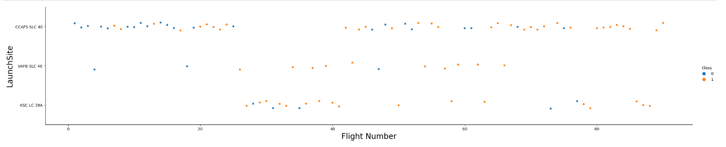
Flight Number vs Launch site

Slide 18
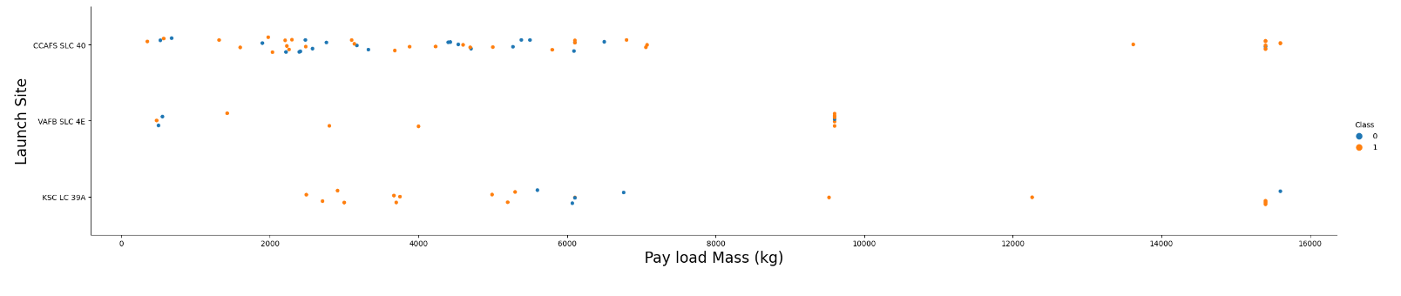
Payload Mass vs Launch Site

Slide 19
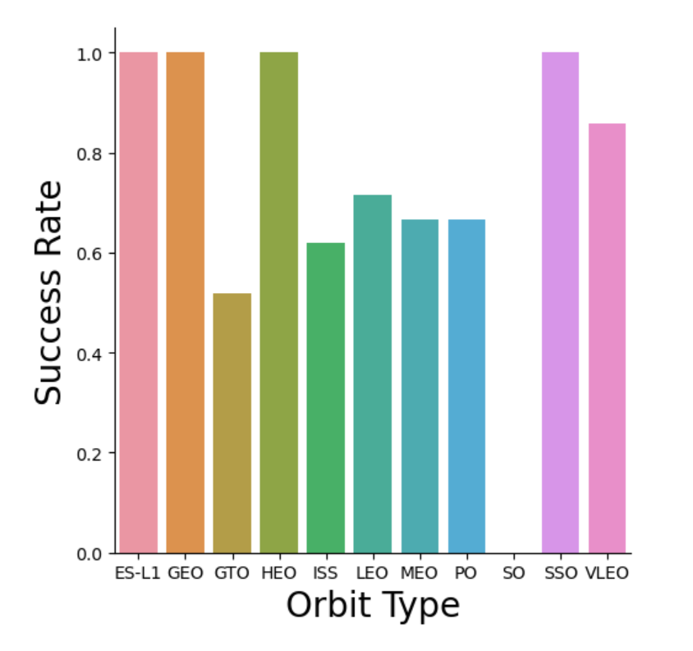
Success rate vs orbit type

Slide 20
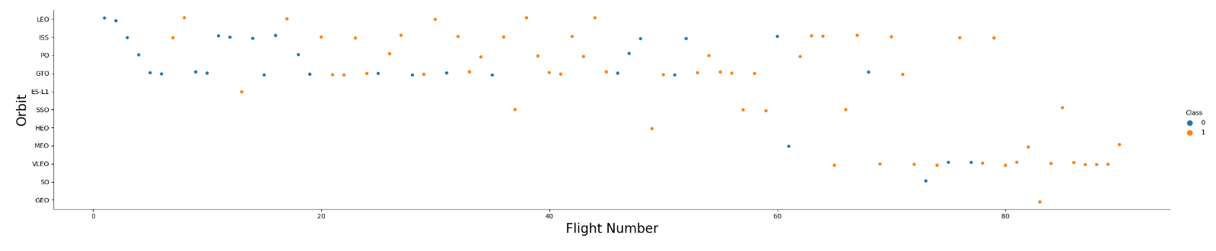
Flight Number vs Orbit

Slide 21
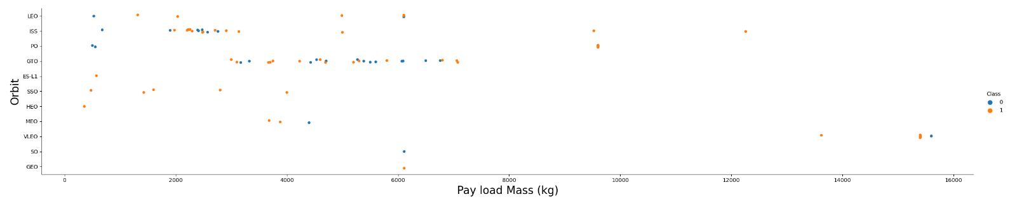
Payload Mass vs Orbit

Slide 22
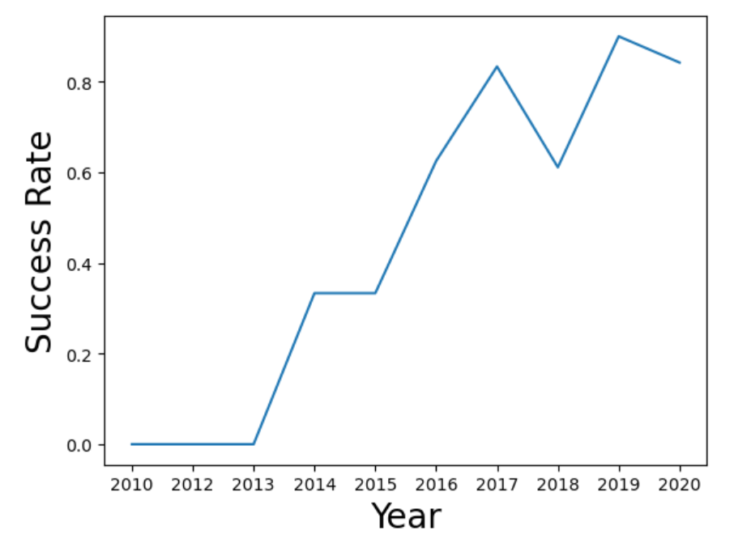
Launch success yearly trend

Slide 23
EDA with SQL

Slide 24
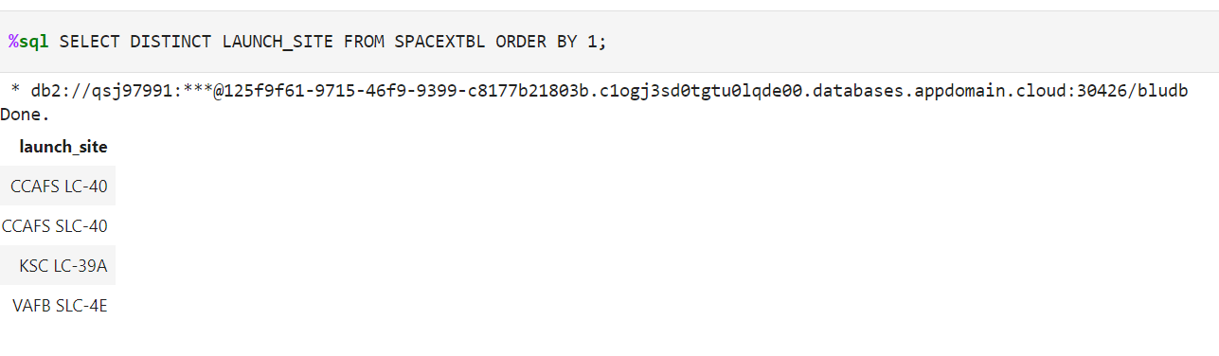
Launch site names

Slide 25
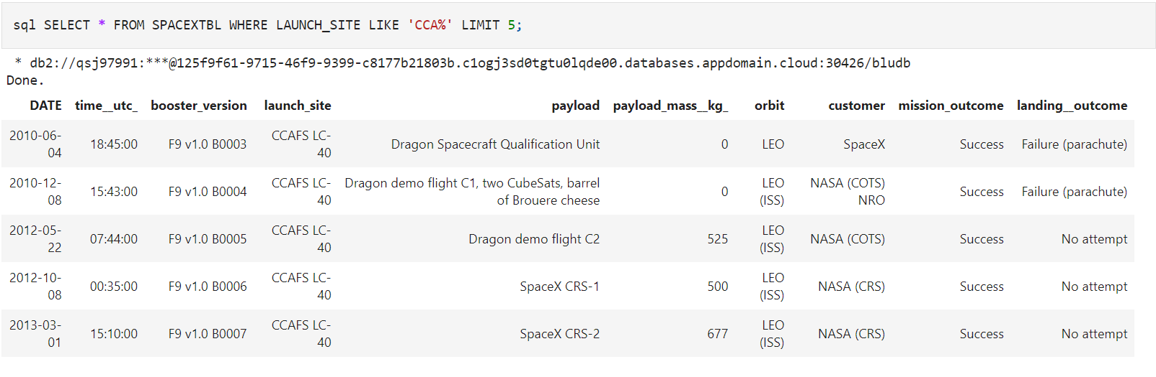
Launch site names that begin with ‘CCA’

Slide 26
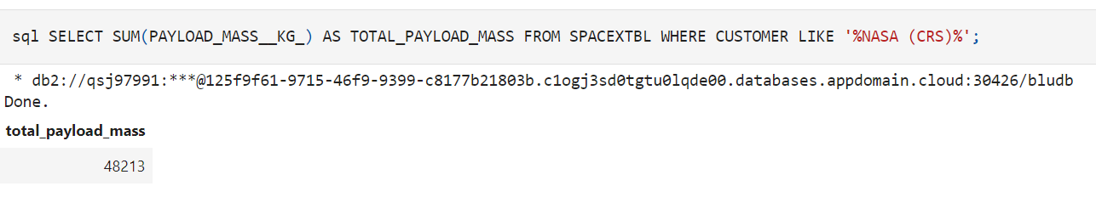
Payload mass carried by NASA (CRS) boosters

Slide 27
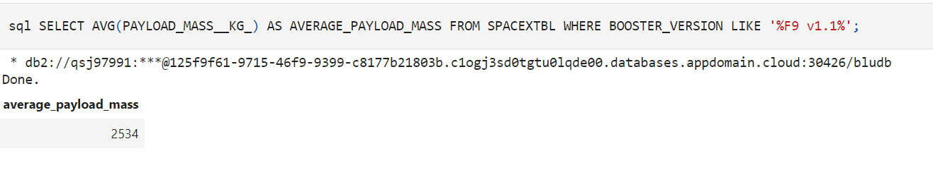
Average payload mass carried by booster version ‘F9 v1.1’

Slide 28
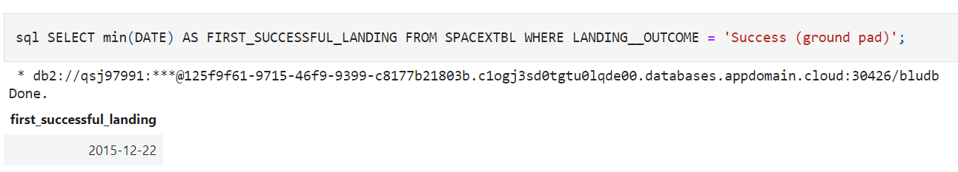
Date of the first successful landing using a ground pad

Slide 29
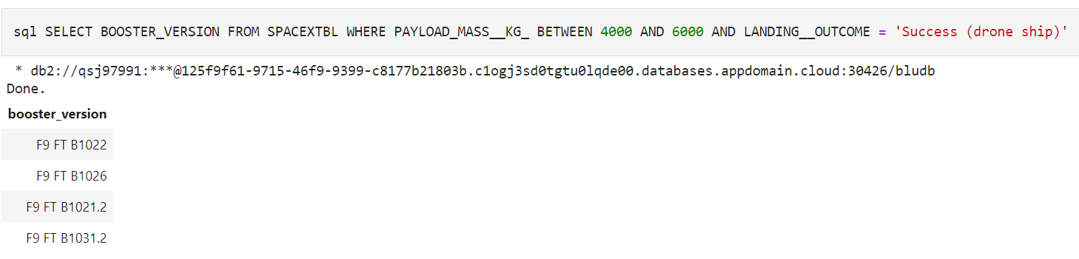
Names of the boosters who have success in drone ship and have payload mass between 4000 and 6000 kg

Slide 30
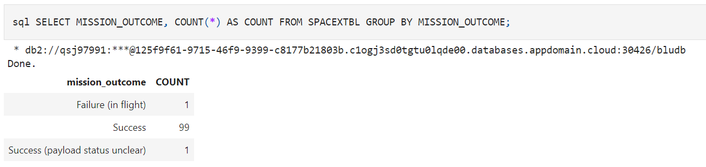
Total number of successful and failed missions

Slide 31
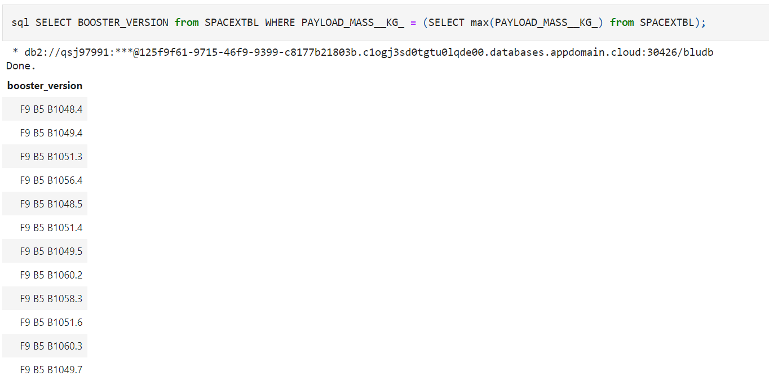
Names of boosters which have carried the maximum payload

Slide 32
Failed landings between 2010-06-04 and 2017-03-20, in descending order

Slide 33
Interactive maps with folium

Slide 34
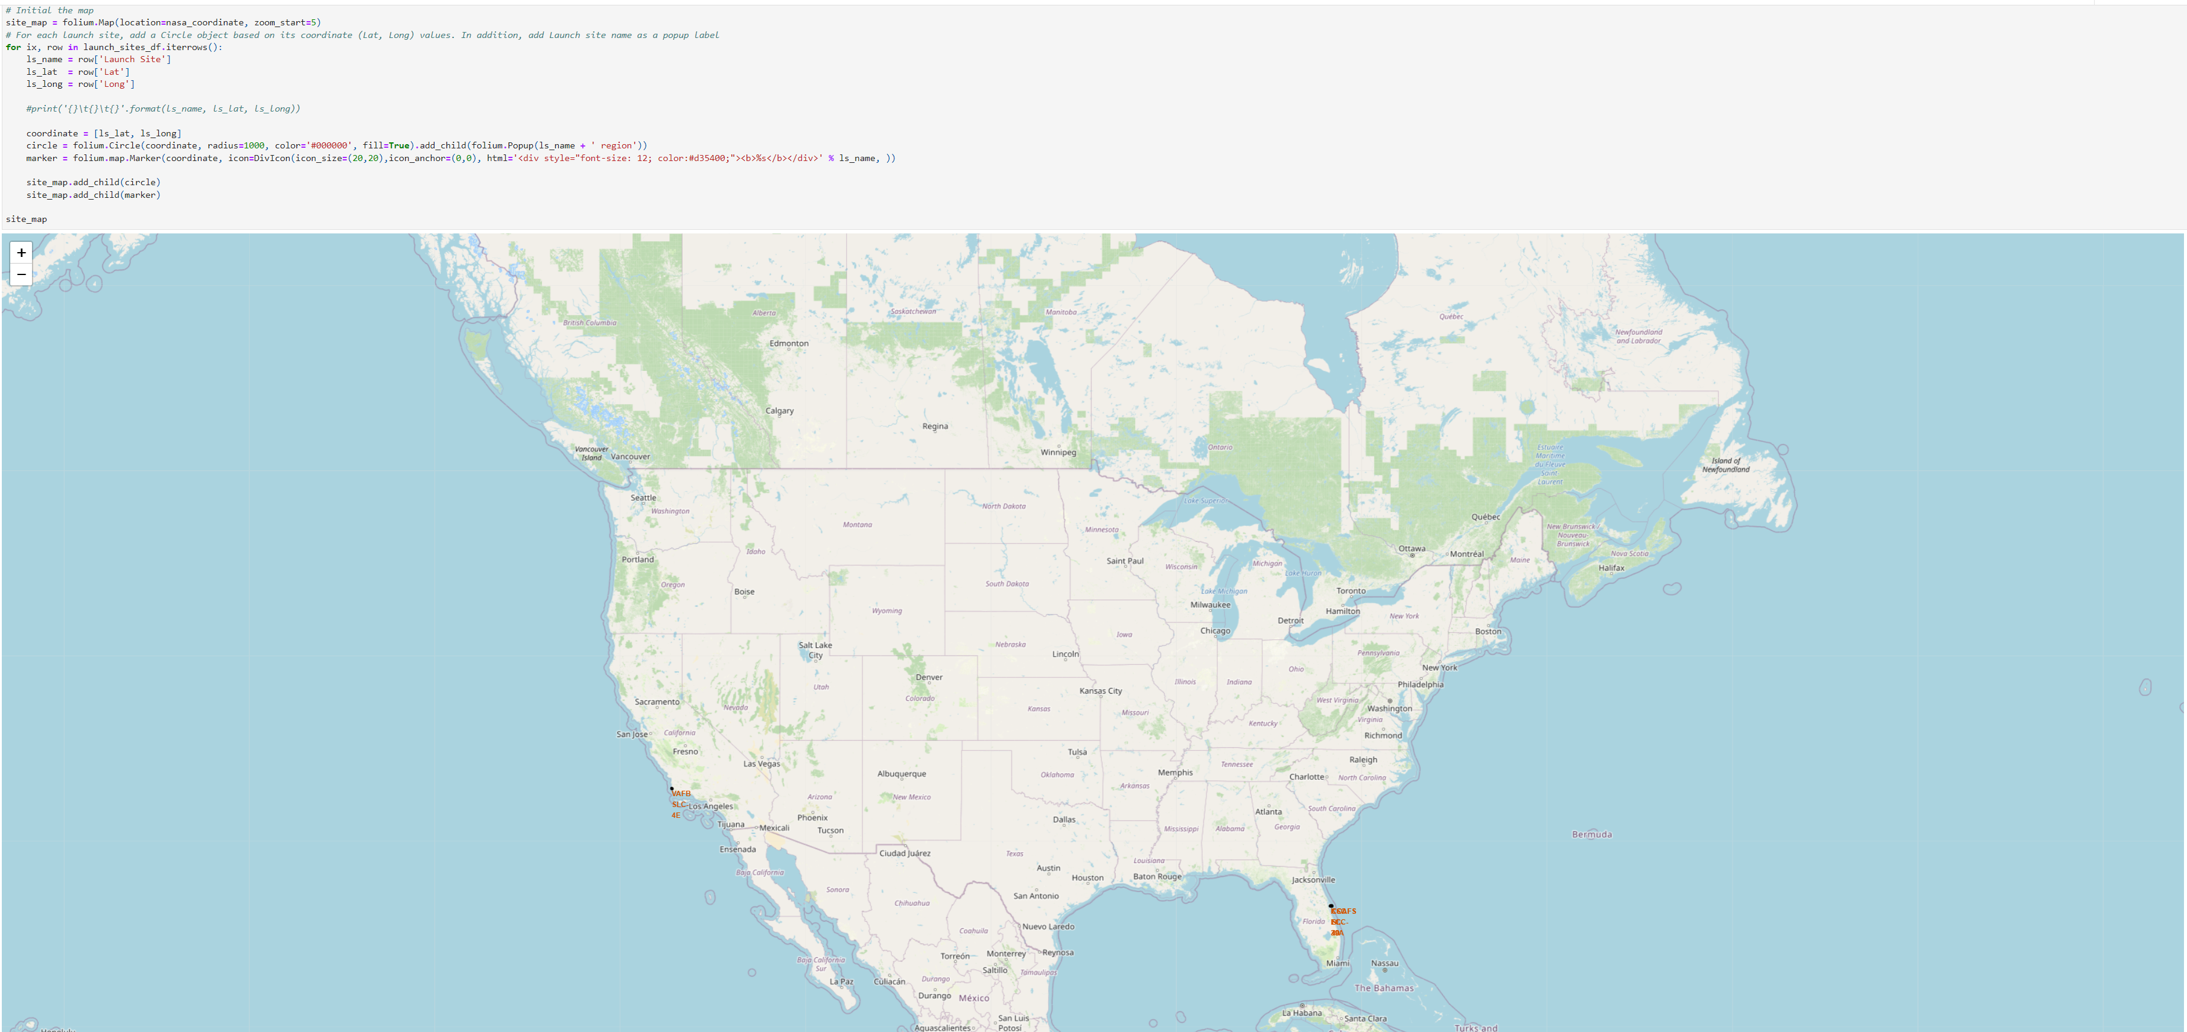
Map of all launch sites

Slide 35
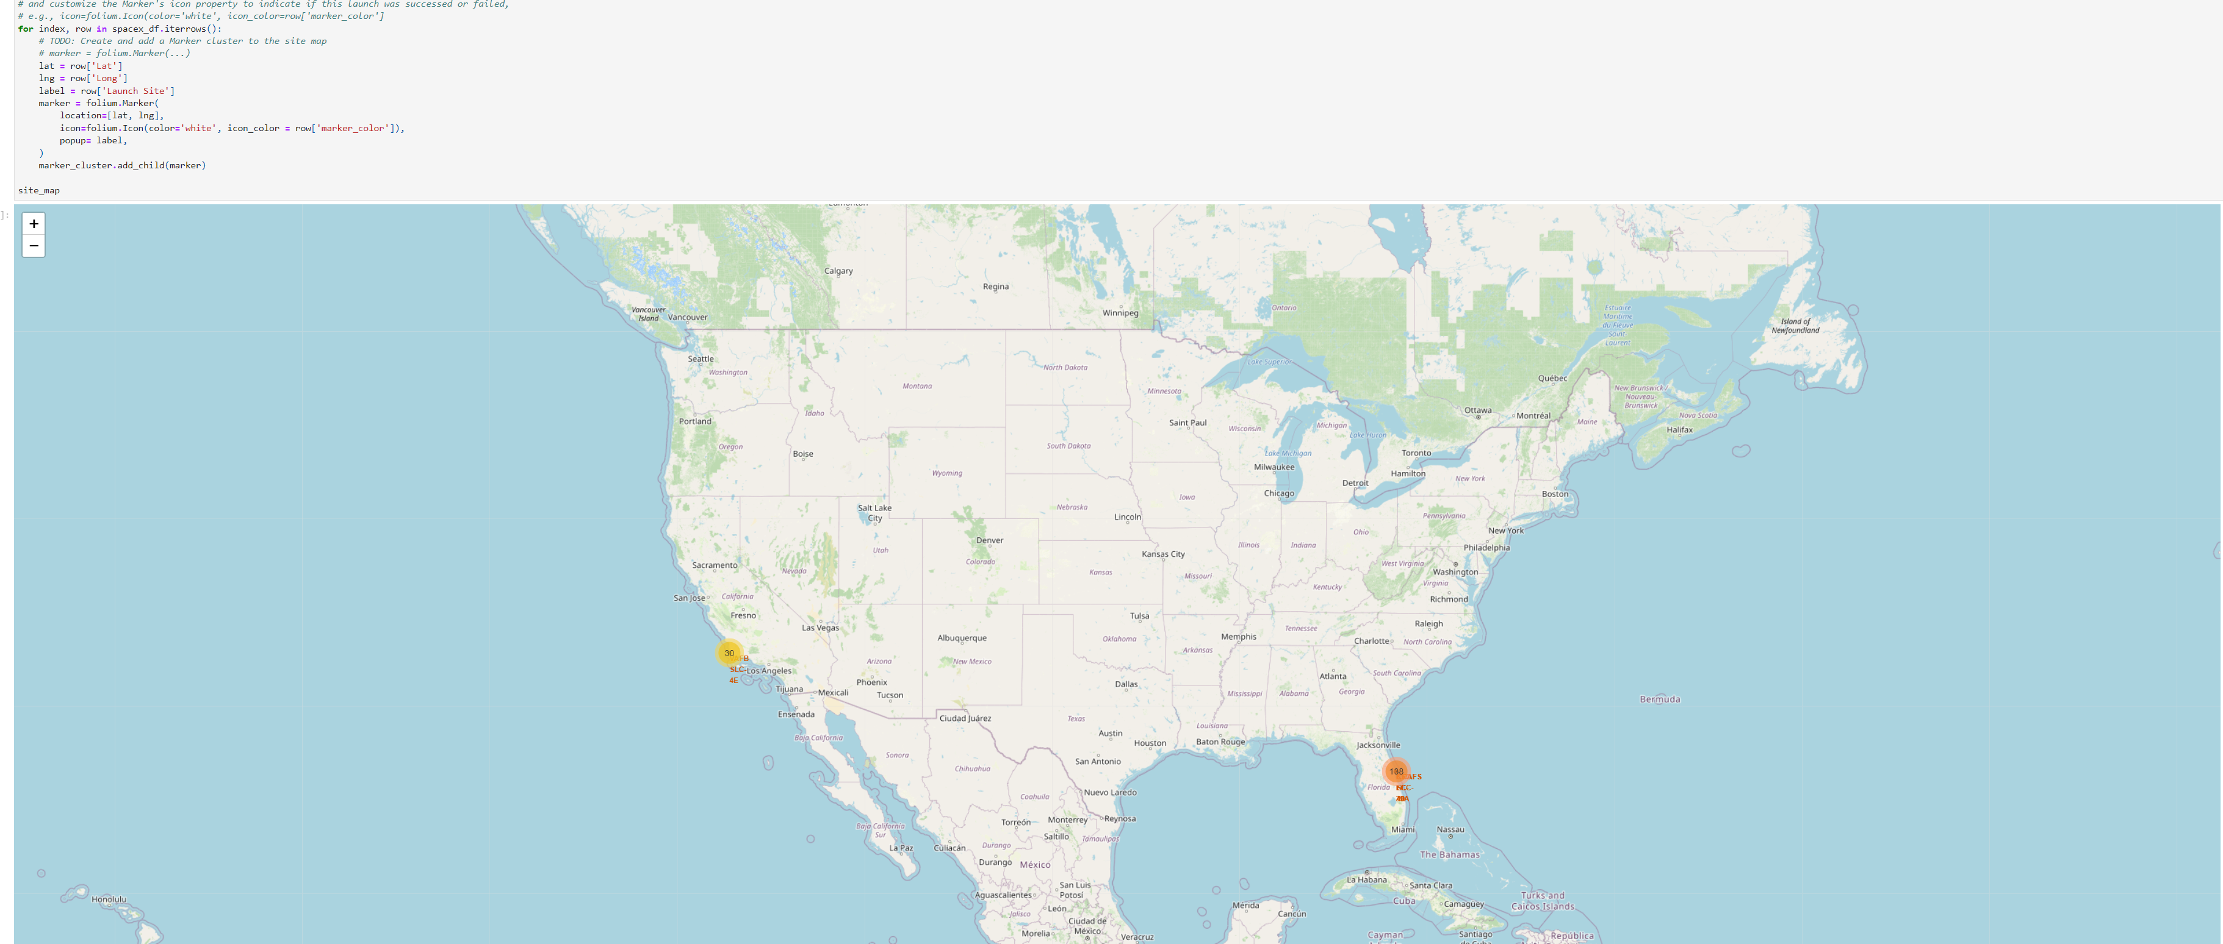
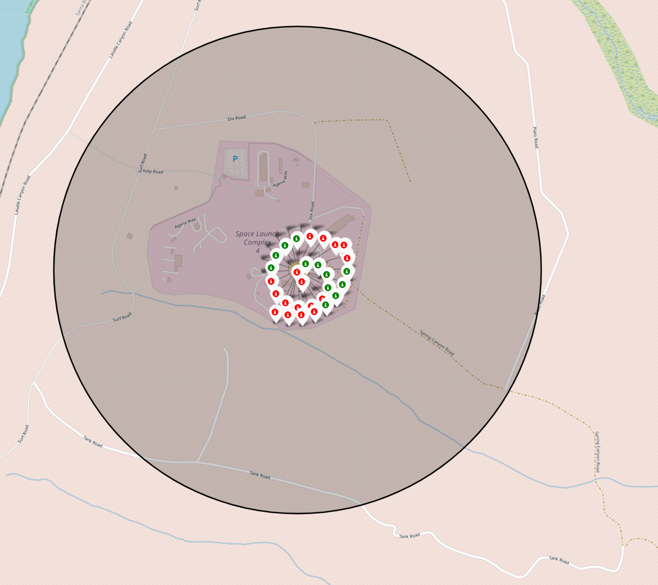
Map with all failed and succeeded launches marked

Slide 36
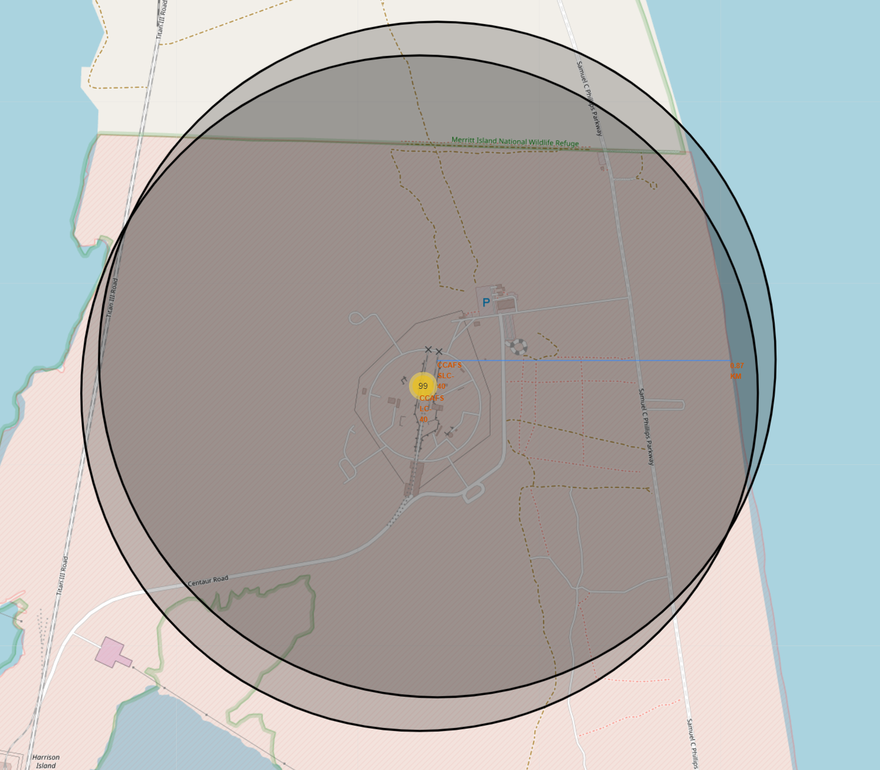
Map with the distance between launch site and proximities

Slide 37
Plotly dash app

Slide 38
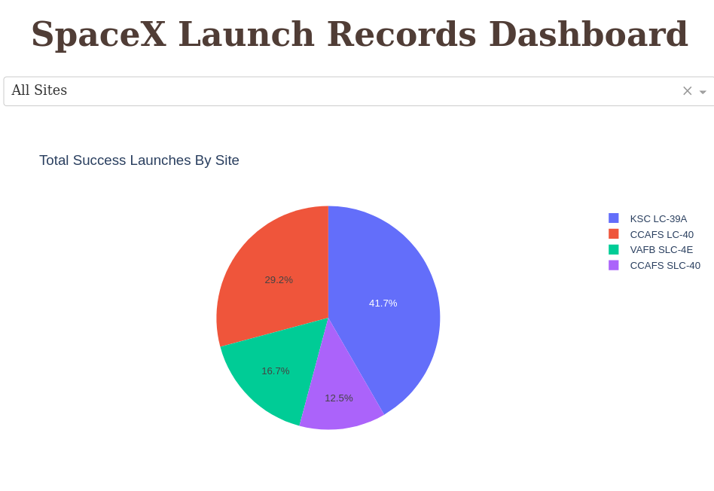
Pie chart for all sites

Slide 39
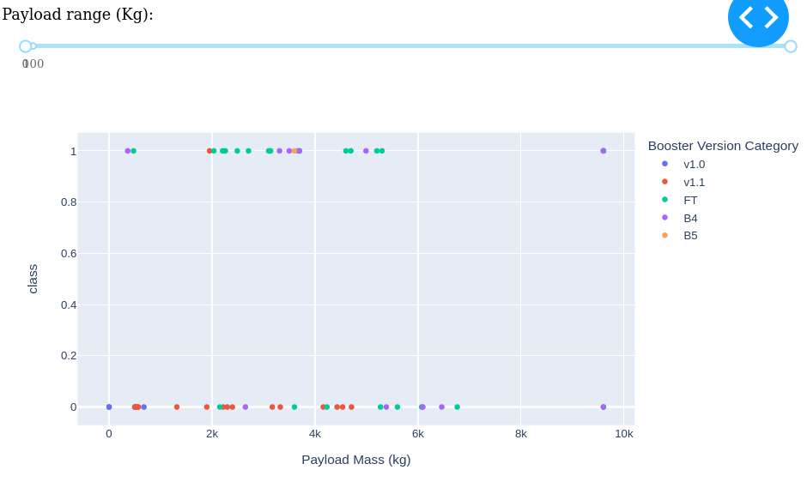
Scatter plot of the payload mass with slider

Slide 40
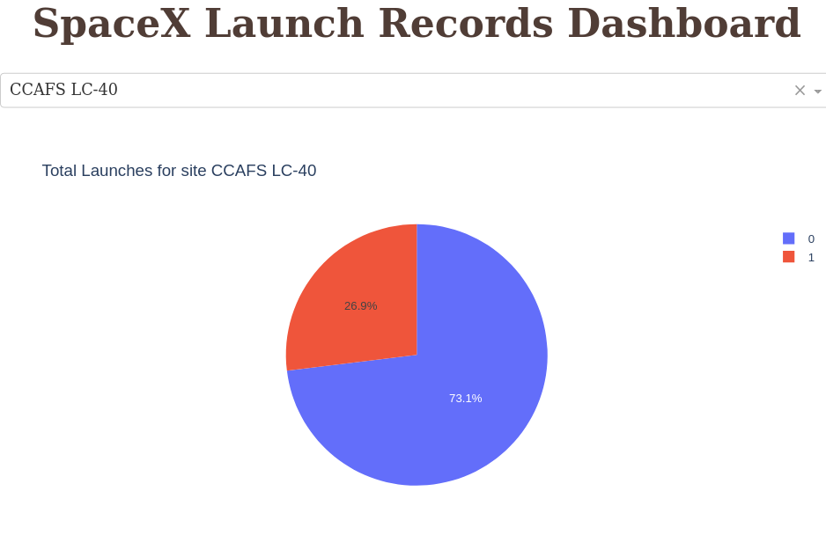
Pie chart for CCAFS LC-40

Slide 41
Predictive analysis

Slide 42
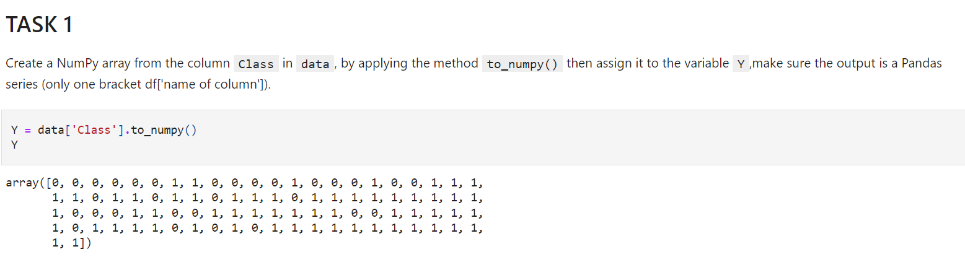

Slide 43
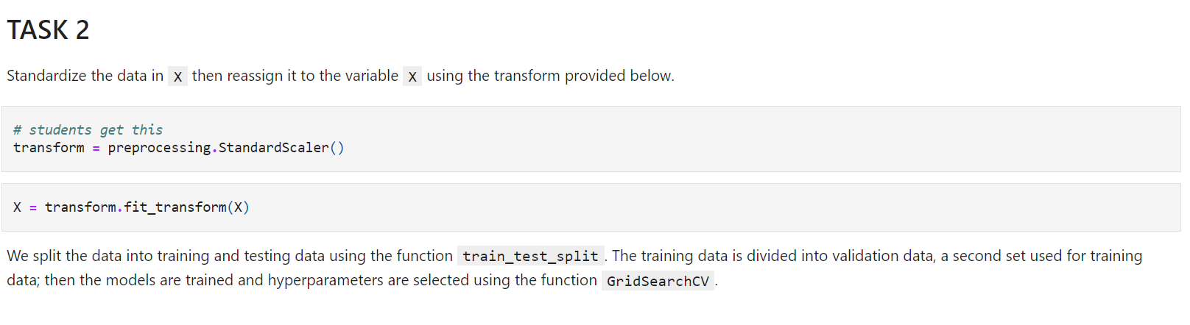

Slide 44
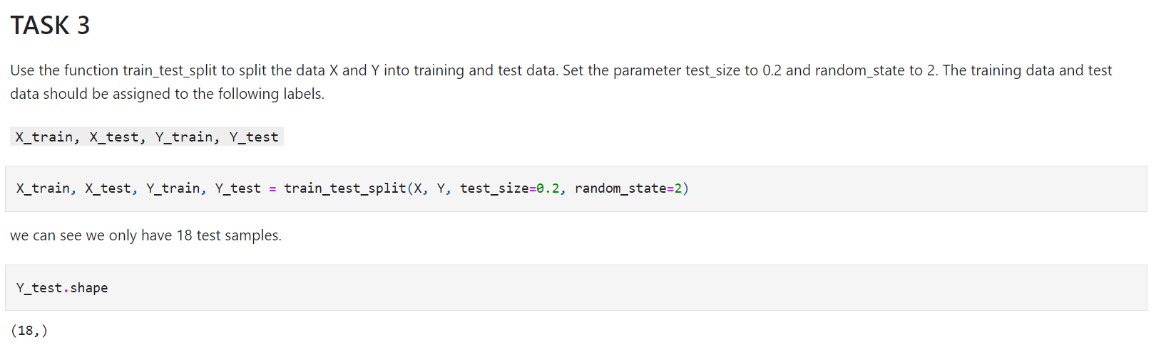

Slide 45
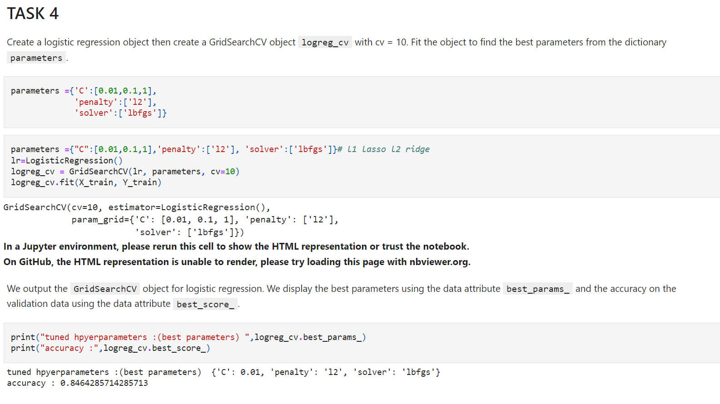

Slide 46
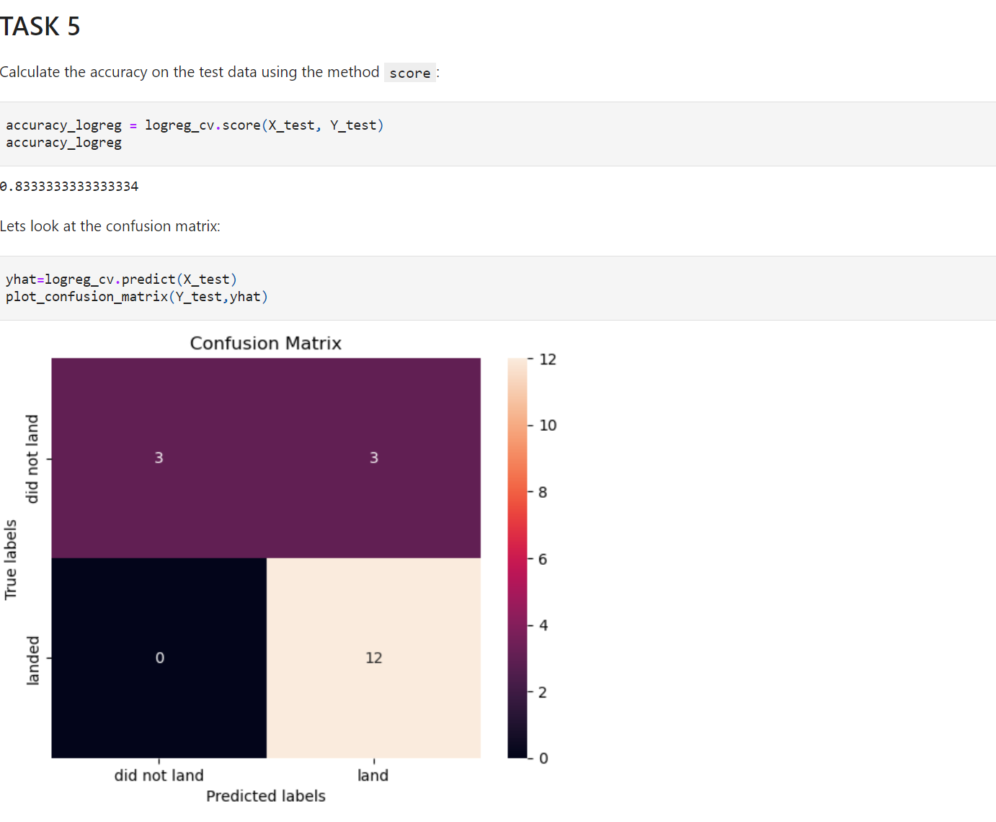

Slide 47
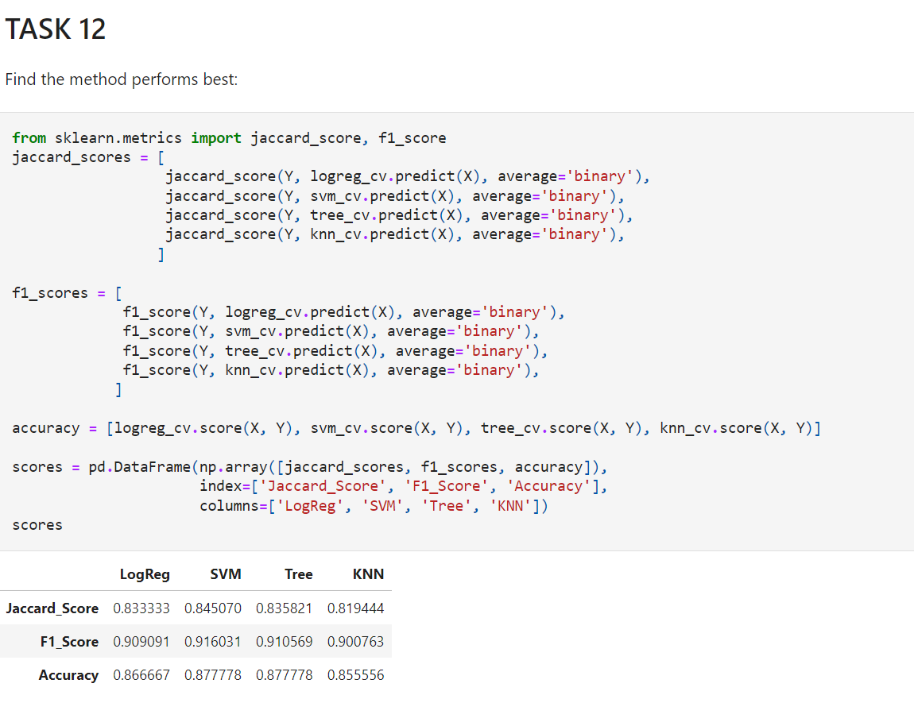

Slide 48

CONCLUSION
In conclusion, by analyzing this data and manipulating it with various methods we can see which parameters and other affects can lead to success and failure in a SpaceX launch

